Slide 1
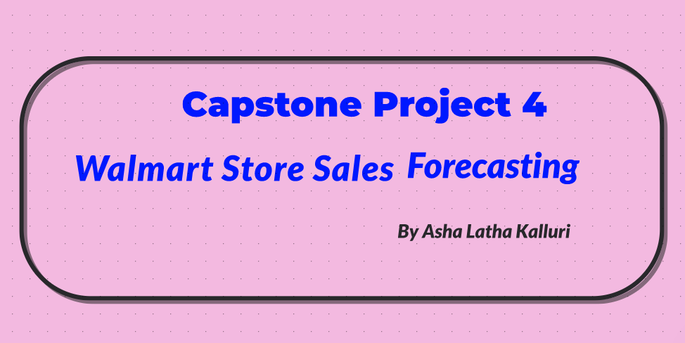

Slide 2
Introduction & Objectives
The project is about Store Sales Forecasting, using historical markdown data to predict store sales.
Target audience are job seekers who can
show case their models and work for Walmart Hiring Team .
To predict the impact on sales due to holiday markdown events and the affect on stores and departments.
My prediction will help to analyze the impact on weekly sales.
Notes:
- Who are you? - What is the organization/department you are representing? - Who is your target audience? - State your business case/statement/goals/motivations - How will your prediction work help

Slide 3
Descriptive Statistics
Importing the libraries,
Then load and merge the data,
Filtered the data,
Data description.

Slide 4
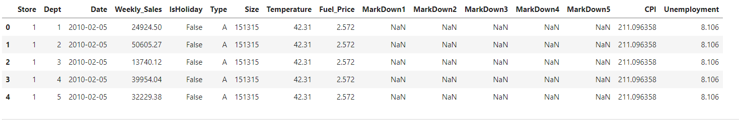
For Train Data set

Slide 5
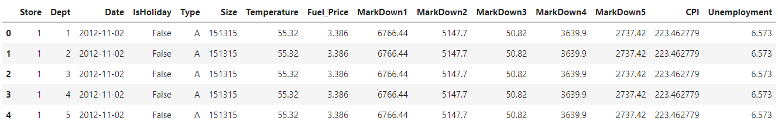
For Test Data set

Slide 6
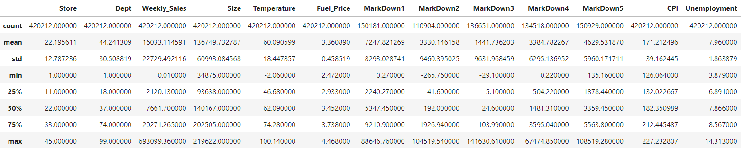
Data description for train data

Slide 7
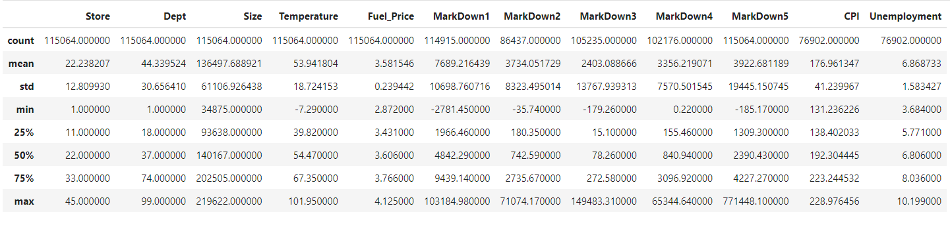
Data description for Test Data

Slide 8
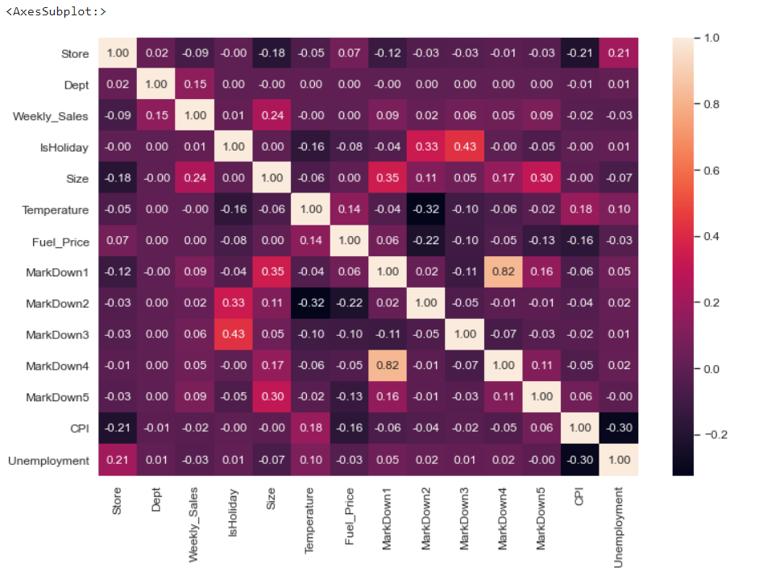
Exploratory Data Analysis (EDA)
Correlation Matrix

Slide 9
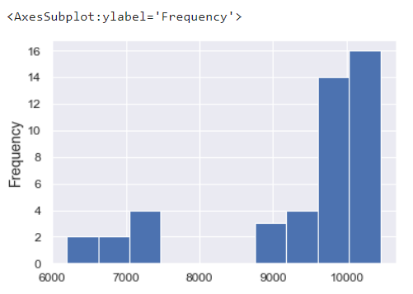
Store Wise Sales

Slide 10
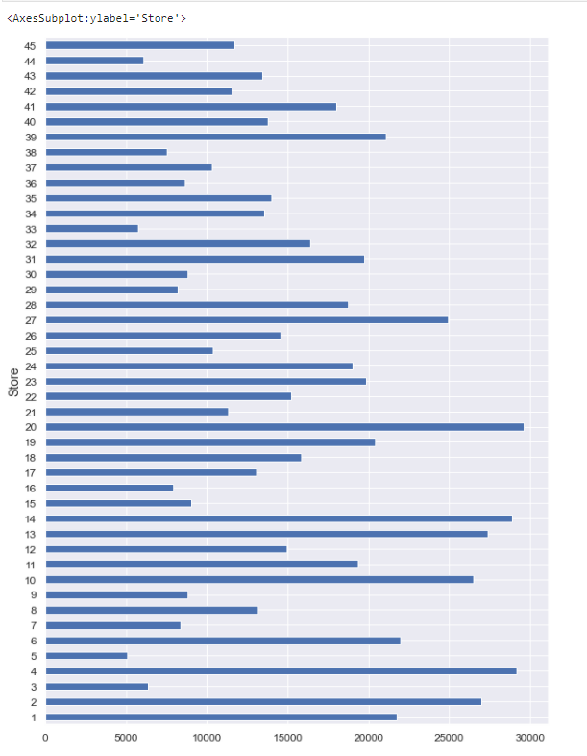
Average weekly sales by store

Slide 11
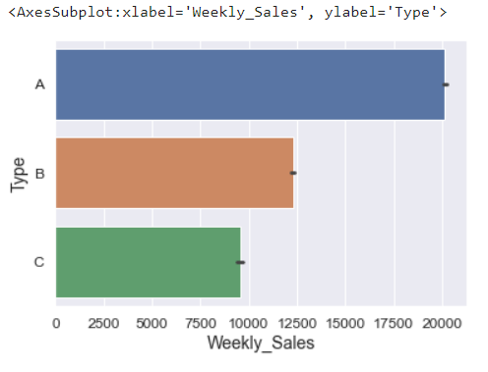
Weekly sales Type wise

Slide 12
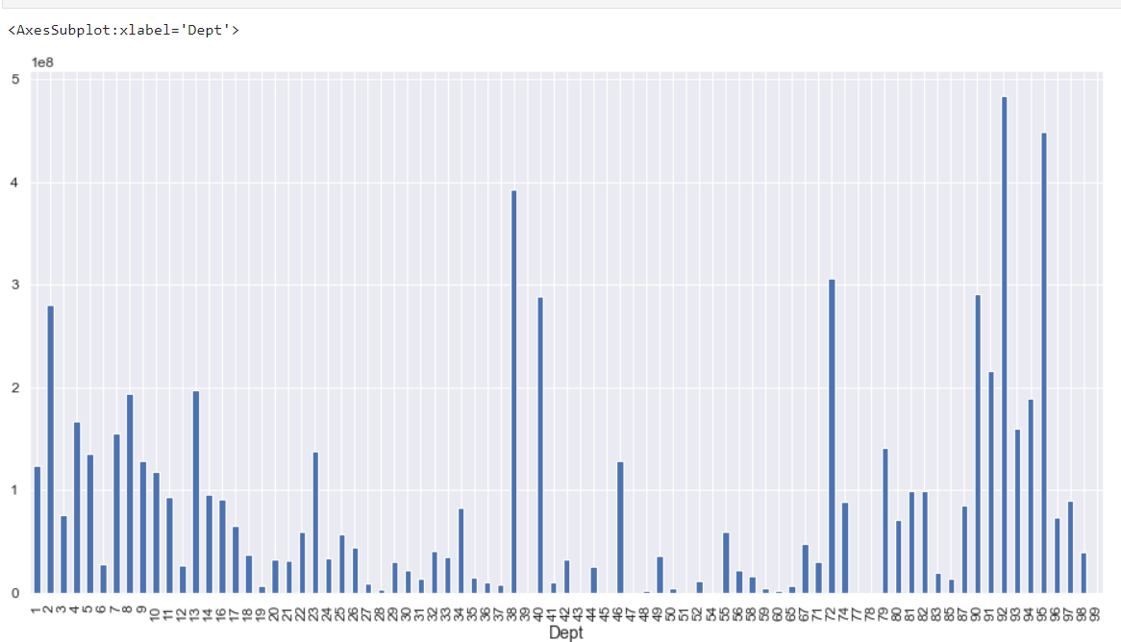
Department Wise sales

Slide 13
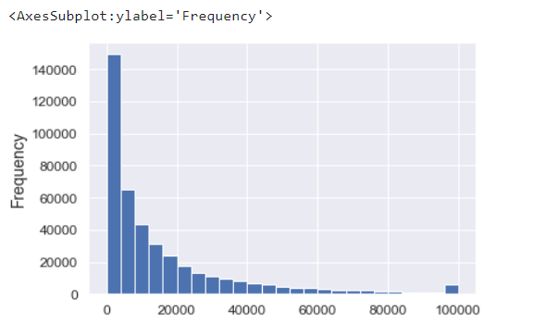
Outliers

Slide 14
Data Preparation : Filled with zero for missing values in markdown. We also convert categorical features into numeric form.
Feature Extraction : From the date feature I extracted day of the week, month,year and day accordingly. Is holiday Feature: In this feature we can calculate the number of days that comes under holidays.
Train and test the data : We train and test the data. After that I converted all categorical values into numerical values. For Training and testing new columns has been created to identify the dates falling on extra holiday in the sales . And finally merged all those columns into Is holiday. Now the extra holidays are redundant. So, I dropped the extra holiday columns.
Feature Selection : Dropped the redundant Extra holiday variables.

Slide 15
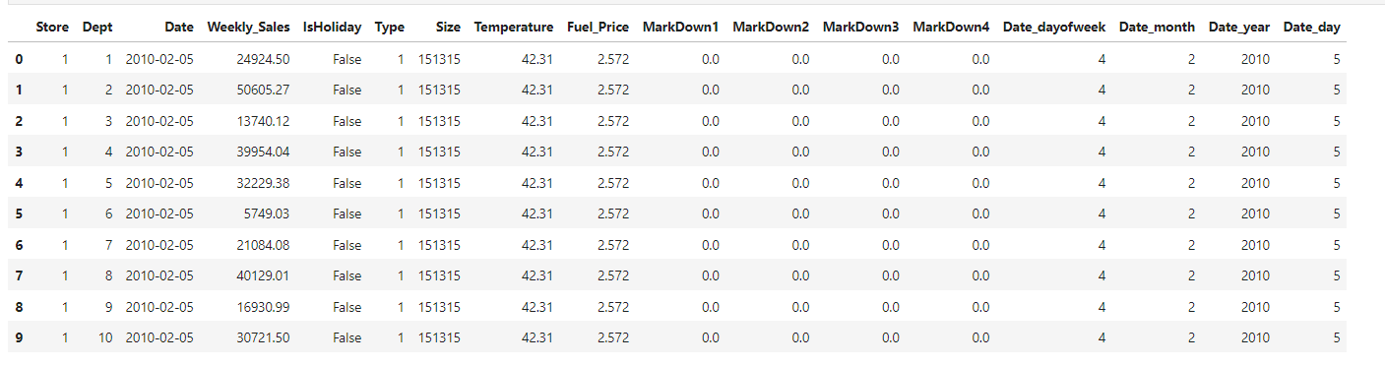

Slide 16
Machine Learning Models
Linear Regression
Random forest
Decision Tree

Slide 17
Performance Metrics (Regression) : - Mean Absolute Error -Sum of the absolute differences between predictions and actual values. - The mean absolute error (MAE) is a quantity used to measure how close predictions are to the outcomes. MAE is more robust to data with outliers. The lower value of MAE implies higher accuracy of a regression model. The actual amount of error during a measurement is referred to as absolute error. It helps us to understand the amount of error that is being measured.

Slide 18
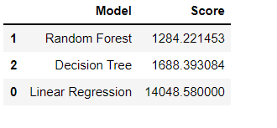
Comparing Models

Slide 19
Conclusion:
With the increasing use of machine learning Job seekers can boost efficiency and productivity of the weekly sales in Store Sales Forecasting.There is a real need for machine learning to identify the models like Linear Regression, Decision tree and Random forest to predict the impact on sales due to holiday markdown events and the affect on stores and departments .Job seekers analyse the huge sales data and present their analysis to organisers for improving the sales during selected holiday markdown events. To conclude finally ,Random forest has scored less score and proved as a best fit for this store sales forecasting.

Slide 20
Source: https://www.kaggle.com/c/walmart-recruiting-store-sales-forecasting/data
Thank you.

